Slide 1
Piggy Backing, Aloha

Slide 2
Piggy Backing
A technique called piggybacking is used to improve the efficiency of the bidirectional protocols.
When a frame is carrying data from A to B, it can also carry control information about arrived (or lost) frames from B; when a frame is carrying data from B to A, it can also carry control information about the arrived (or lost) frames from A.

Slide 3
Piggy Backing
Piggybacking is like jumping on someone else's ride to get where you want to go, without having your own transportation.
In a tech sense, it's using someone else's connection or resources to access or transmit data without setting up your own connection.

Slide 4
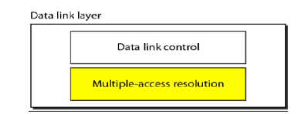
RANDOM ACCESS PROTOCOLS
We can consider the data link layer as two sub layers. The upper sub layer is responsible for data link control, and the lower sub layer is responsible for resolving access to the shared media.

Slide 5
RANDOM ACCESS PROTOCOLS
The upper sub layer that is responsible for flow and error control is called the logical link control (LLC) layer; the lower sub layer that is mostly responsible for multiple access resolution is called the media access control (MAC) layer.
When nodes or stations are connected and use a common link, called a multipoint or broadcast link, we need a multiple-access protocol to coordinate access to the link.

Slide 6
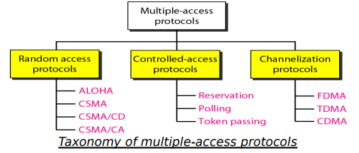
Multiple Access Protocols Taxonomy

Slide 7
Contention Methods/Random Access
In random access or contention methods, no station is superior to another station and none is assigned the control over another. Two features give this method its name.
First, there is no scheduled time for a station to transmit. Transmission is random among the stations. That is why these methods are called random access.
Second, no rules specify which station should send next. Stations compete with one another to access the medium. That is why these methods are also called contention methods.

Slide 8
Aloha
In computer networking, "Aloha" refers to a simple network protocol for sharing resources among multiple users.
The Aloha protocol was developed at the University of Hawaii in the 1970s. It is primarily used in the context of early Ethernet and wireless communication.

Slide 9
Types of Aloha
Pure Aloha: In Pure Aloha, a device can send data at any time. If there is no collision with other transmissions, the data is successfully sent. However, if there is a collision, the data needs to be resent after a random waiting time.
Slotted Aloha: Slotted Aloha divides time into slots and allows devices to transmit data only at the beginning of each slot. This reduces the chances of collision, as devices are synchronized to the time slots. Like Pure Aloha, if a collision occurs, the device waits for a random time before attempting to transmit again.

Slide 10
Pure Aloha
The original ALOHA protocol is called pure ALOHA. This is a simple, but elegant protocol. The idea is that each station sends a frame whenever it has a frame to send.
However, since there is only one channel to share, there is the possibility of collision between frames from different stations. Below Figure shows an example of frame collisions in pure ALOHA.

Slide 11
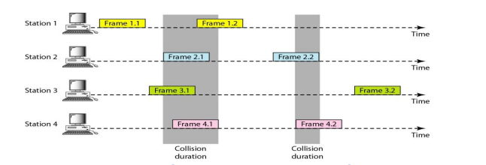
Pure Aloha

Slide 12
Vulnerable Time
In Pure Aloha, the vulnerable time is the period during which a collision can occur. Imagine it like a window of time where two devices might accidentally talk over each other, causing a collision.
The vulnerable time is crucial because collisions can disrupt data transmission.
After a device sends its data, it needs to listen for a response. If another device starts talking during this vulnerable time, a collision happens, and both devices have to try sending their data again after waiting for a random amount of time.
So, the vulnerable time is the part of the process where conflicts can happen.

Slide 13
Calculation of Tv
The Vulnerable time can be calculated using the formula:
Tv = 2 * propagation Delay (PD)
Propagation delay is the time it takes for a signal to travel from the sender to the receiver. It depends on the distance between the devices and the speed of the transmission medium (usually the speed of light in the specific medium).

Slide 14
Example
Imagine two devices, A and B, are communicating using Pure Aloha on a shared communication channel. The propagation delay for the channel is 10 milliseconds.
Propagation Delay (PD) = 10 milliseconds
Formula: Tv=2×PD
Substitute the given value: Tv=2×10milliseconds
Tv=20milliseconds

